Slide 1
How do LLMs Work?
The main engine of chatbots

Slide 2
Artificial Intelligence
Artificial Intelligence
Machine Learning
Generative AI
Large Language Model

Slide 3






Large Language Models
Prompt
(Input)
LMM
(Agent)
Output

Slide 4
LLM Workflow
Paris is a
Paris is a beautiful
Paris is a beautiful city

Slide 5




How to Build an LLM?
Phase1:
Pre-training
Phase2:
Fine-tuning
Phase3:
RLHF

Slide 6
LLM Challenges
Hallucination
High Computational Cost
Reasoning Errors
Knowledge Cutoff
Data Sensitivity
Context Window Limitations

Slide 7
Prompt Engineering
How to chat with LLMs properly?

Slide 8
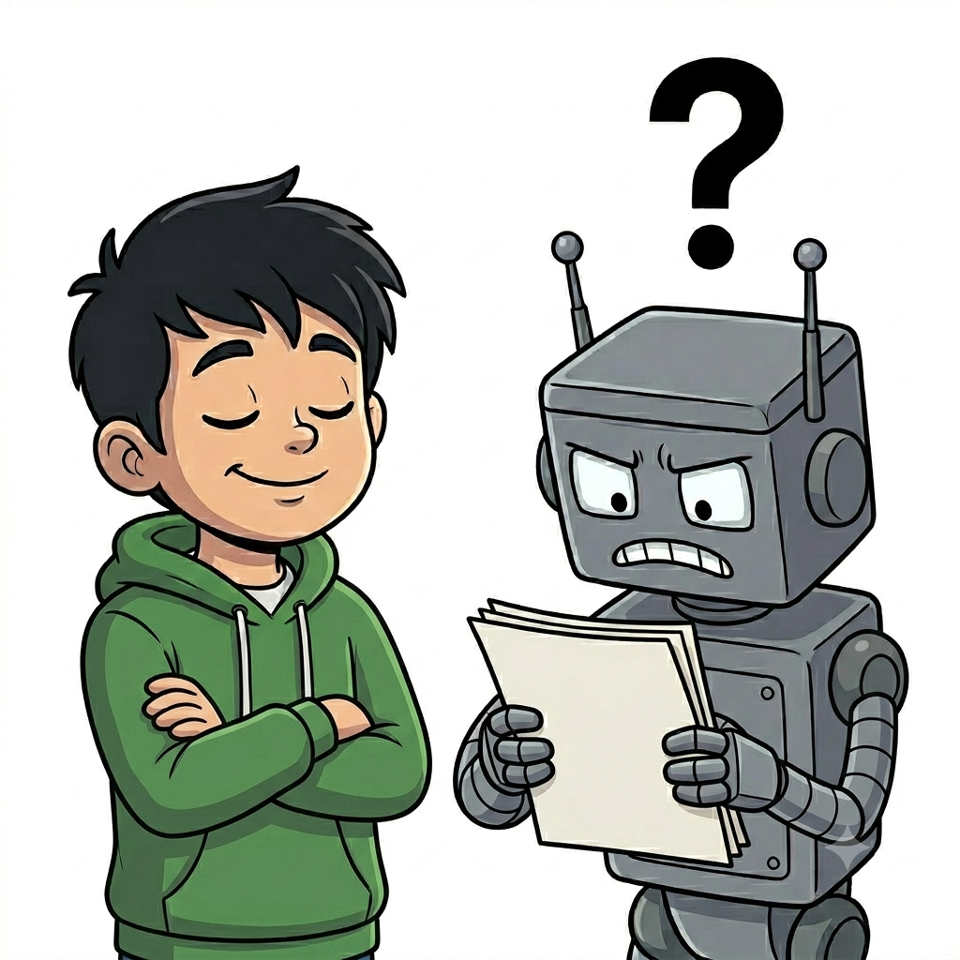
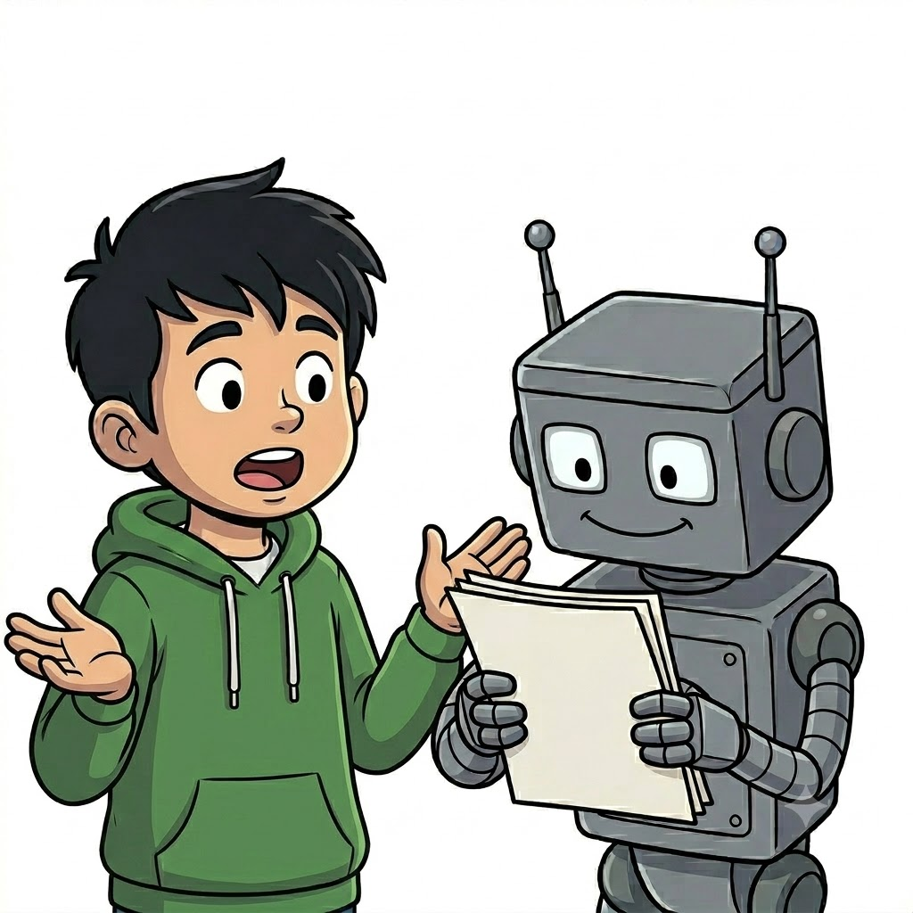
Good vs. Bad Prompt
Bad Prompt
Good Prompt

Slide 9
Example of
Good & Bad Prompt
Bad Prompt
Good Prompt
Write an email to my boss.
Write a professional email to my boss requesting 3 days of leave (March 10–12). I have completed all urgent tasks beforehand. The tone should be polite and responsible. Keep it concise (under 120 words).
Notes:
Bad Prompt : Write an email to my boss.
Good Prompt: Write a professional email to my boss requesting 3 days of leave (March 10–12). I have completed all urgent tasks beforehand. The tone should be polite and responsible. Keep it concise (under 120 words).

Slide 10

What is Prompt Engineering?
Prompt engineering is the practice of designing and refining inputs (prompts) to guide large language models to produce better, more accurate, and more useful outputs. It involves choosing clear instructions, context, format, and constraints to control the model’s behavior and improve results.

Slide 11
Homework 1
با توجه به مطالبی که در کلاس آموختید ایرادات پرامپت زیر را لیست کنید و نسخه ی اصلاح شده را ارسال کنید.
Write an article about chatbots and LLMs in Farsi.

